Slide 1
Lecture 20
Learning
Yaohang Li
Department of Computer Science
ODU
Reading for This Class:
Chapters 15, 16

Slide 2
Review
Last Class
Swarm Intelligence
Ant Colony Optimization
Ant Clustering
This Class
Learning
Next Class
Artificial Neural Network

Slide 3
Machine Learning
Concepts and Definitions given by Tom M. Mitchell
Machine learning is the study of computer algorithms that improve automatically through experience.
Machine learning is an inherently interdisciplinary field, built on concepts from artificial intelligence, probability and statistics, information theory, philosophy, control theory, psychology, neurobiology, and other fields.
Learning:
A computer program is said to learn from experience E with respect to some class of tasks T and performance measure P, if its performance at tasks in T, as measured by P, improves with experience E.

Slide 4
Introduction to Learning Agents
Learning Agent
Performance element
Decides what actions to take
Learning element
Modifies the performance element so that it makes better decision
Three design issues
Which components of the performance element are to be learned
What feedback is available to learn these components
What representation is used for the components
Most agents learn from examples
inductive learning

Slide 5
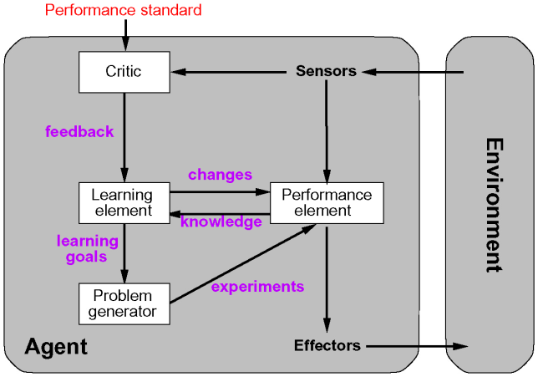
Learning Agent Model

Slide 6
Performance Element Components
Multitude of different designs of the performance element
corresponding to the various agent types discussed earlier
Candidate components for learning
mapping from conditions to actions
methods of inferring world properties from percept sequences
changes in the world
exploration of possible actions
utility information about the desirability of world states
goals to achieve high utility values

Slide 7
Component Representation
many possible representation schemes
weighted polynomials (e.g. in utility functions for games)
propositional logic
predicate logic
probabilistic methods (e.g. belief networks)
learning methods have been explored and developed for many representation schemes

Slide 8
Feedback
provides information about the actual outcome of actions
supervised learning
a learning method where both the input and the output of a component can be perceived by the agent directly
the output may be provided by a teacher
unsupervised learning
Learning patterns from the input
No specific output values are supplied
reinforcement learning
feedback is available, but not directly attributable to a particular action
feedback may occur only after a sequence of actions
the agent or component knows that it did something right, but not what action caused it

Slide 9
Types of learning
Auto taxi driver agent
learns condition-action rules for when to brake
when the instructor shouts “Brake”
2) seeing camera images containing buses
learn to recognize them
3) tries actions and observes the results
braking hard on a wet road
4) learns its utility function
lack of tips at the end of the journey indicate its behavior is not desirable
Supervised learning - learning a function from examples of its inputs and outputs
case 1), 2), 3)
Unsupervised learning – learning patterns in the input when no specific output values are supplied
automatically grouping the samples into classes – clustering
Reinforcement learning – learning in situations that the feedback is kind of reward, which says something good or bad has happened
case 4)

Slide 10
Prior Knowledge
background knowledge available before a task is tackled
can increase performance or decrease learning time considerably
many learning schemes assume that no prior knowledge is available
in reality, some prior knowledge is almost always available
but often in a form that is not immediately usable by the agent

Slide 11
Inductive Learning
Pure Inductive inference (induction)
Given a collection of examples of f, return a function h that approximates f
Tries to find a function h that approximates a set of samples defining a function f
the samples are usually provided as input-output pairs (x, f(x))
Function h is called a hypothesis
Good hypothesis generalize well – predict unseen examples correctly

Slide 12
Example Inductive Learning 1
input-output pairs displayed as points in a plane
the task is to find a hypothesis (functions) that connects the points
either all of them, or most of them
various performance measures
number of points connected
minimal surface
lowest tension
f(x)
x

Slide 13
Example Inductive Learning 2
hypothesis is a function consisting of linear segments
fully incorporates all sample pairs
goes through all points
very easy to calculate
has discontinuities at the joints of the segments
moderate predictive performance
f(x)
x

Slide 14
Example Inductive Learning 3
hypothesis expressed as a polynomial function
incorporates all samples
more complicated to calculate than linear segments
no discontinuities
better predictive power
f(x)
x

Slide 15
Example Inductive Learning 4
hypothesis is a linear functions
does not incorporate all samples
extremely easy to compute
low predictive power
f(x)
x

Slide 16
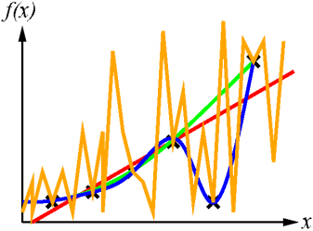
Inductive learning
Construct/adjust h to agree with f on training set
h is consistent if it agrees with f on all (training) examples
E.g., curve fitting:
How do we choose from among multiple consistent hypotheses?
Ockham’s razor: prefer the simplest hypothesis consistent with the data

Slide 17
Decision tree learning
Regression learning – learning continuous function
Classification learning – learning discrete-valued function
Boolean classification classification of examples is positive (T) or negative (F)
A decision tree
simplest yet useful inductive learning algorithm
takes as input an example described by a set of attributes and returns a “decision” – the predicted output value for the input
An example: whether to wait for a table at a restaurant
To learn a definition for the goal predicate WillWait
Need attributes that describes examples in the domain

Slide 18
Attributes for restaurant problem
1. Alternate: whether there is a suitable alternative restaurant nearby
2. Bar: whether the restaurant has a comfortable bar area to wait in
3. Fri/Sat: true on Fridays and Saturdays
4. Hungry: whether we are hungry
5. Patrons: how many people are in the restaurant (values are None, Some, and Full)
6. Price: the restaurant’s price range ($, $$, $$$)
7. Raining: whether it is raining outside
8. Reservation: whether we made a reservation
9. Type: the kind of restaurant (French, Italian, Thai, or burger)
10. WaitEstimate: the wait estimated by the host (0 – 10 minutes, 10 – 30, 30 – 60, >60)

Slide 19
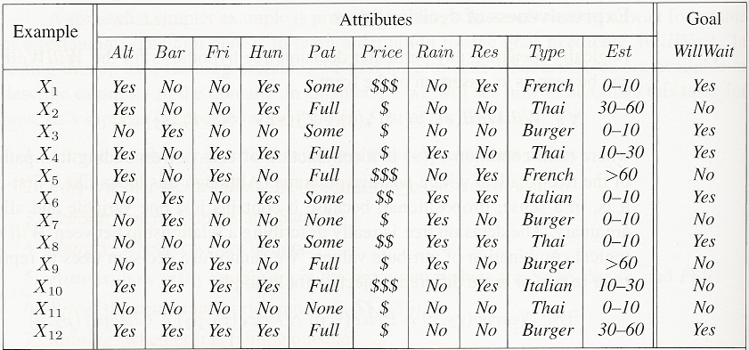
Attribute-based presentation
An example for Boolean decision tree consists of a vector of input attributes, X, and a single Boolean output value y.
e.g., positive examples: WillWait is Yes
Training set – the complete set of examples for finding the hypothesis (tree)
Examples for the restaurant domain.

Slide 20
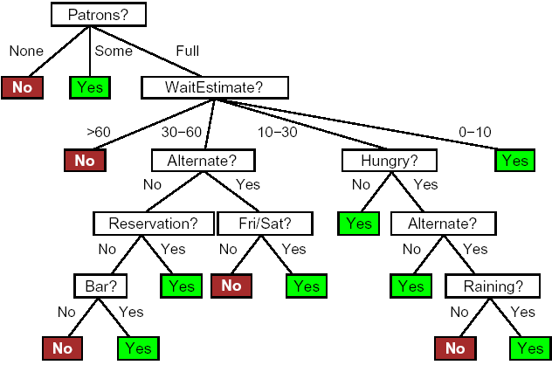
Decision trees
Making decision by performing a sequence of tests
Each internal node in the tree corresponds to a test of the value of one of the attributes
Branches for the node are labeled with possible values of the test
Each leaf node specifies the value to be returned (if it is reached)
A decision does not use the Price and Type attributes --considering them to be irrelevant))

Slide 21
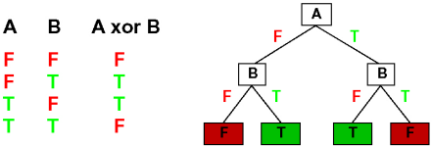
Expressiveness of decision trees
Decision trees can express any Boolean function
truth table row path to leaf
We can build a trivial decision tree for any training set with one path to leaf for each example
just memorizes the observations, i.e., does not extract any pattern (rule), so it cannot extrapolate (generalize) to new (it has not seen) examples
We should find the smallest decision tree that is consistent with the examples
finding the smallest is intractable ☹
how to find a “smallish” (compact) one?
– to test the most important (efficient) attribute first

Slide 22
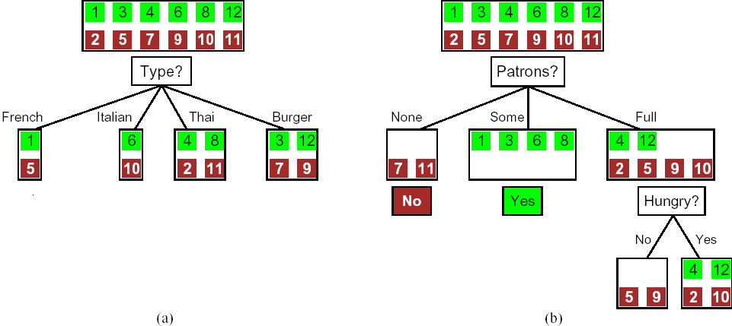
Choosing an attribute
Idea: a good attribute splits the examples into subsets that are (ideally) “all positive” or “all negative”
Patron? is a better choice because it leaves us with example sets for which we can answer definitively (Yes/No)
After the first attribute test splits up the examples, each outcome is a new decision tree learning problem itself, with fewer examples and one fewer attribute.

Slide 23
Recursive decision trees
Four cases for each recursive problem:
1) some positive and some negative examples
– choose the best attribute to split them
2) all positive (or negative) examples
– done (Yes / No)
3) no examples left (no such example has been observed)
– return a default value calculated from the majority classification at the node’s parent
4) no attributes left but both positive and negative examples (same attributes values but different classifications)
– something is wrong! some of the data are incorrect (noise)
– insufficient attributes or domain is nondeterministic (uncertainty, probability)

Slide 24
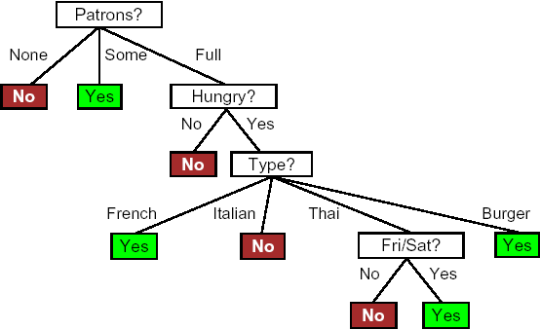
Decision tree learned (induced)
Decision tree learned from the 12 examples
The tree not only agrees with all the examples, but is much simpler than the original tree
Learning algorithm does not include the test for Raining and Reservation?
Because it can classify all the examples without them!

Slide 25
Performance measurement
Good learning algorithm – produces hypotheses (functions) that correctly predicts the classifications of unseen examples
Assessing prediction quality of a hypothesis
Checking its prediction against the correct classification on a set of examples – test set
Collect a large set of examples
Divide it into two disjoint sets: the training set and the test set
Apply the learning algorithm to the training set, generating a hypothesis h
Measure the percentage of examples in the test set that are correctly classified by h
Repeat steps 2 to 4 for different size of training sets and different randomly selected training sets of each size
Plot average prediction quality as a function of the size of the training set – learning curve

Slide 26
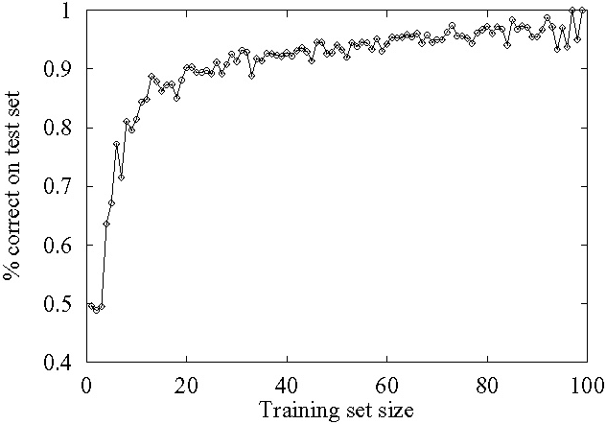
Performance measurement
Learning curve (happy graphs)
% correct on test set as a function of training set size
the prediction quality increases as the training set grows
try h on a new test set of examples (use same distribution over example space as training set)

Slide 27
Summary
Bayesian Network
Noisy-Or
Machine Learning
Learning Agents
Elements
Learning Methods
Three different types of learning
Inductive Learning
Learning Decision Tree
Generating learning decision tree
Performance Measure
Pattern Recognition with Neural Network

Slide 28
What I want you to do
Work on your assignment
Work on your term project

